Slide 1

Project Title –AIRBNB HOTEL BOOKING ANALYSIS
Name:Sudarshan Santosh Khot
AICTE Internship ID : STU67a31ef13d9691738743537
Internship_ID:INTERNSHIP_17546440516895be537820f

Slide 2

PROBLEM STATEMENT
With the growing popularity of Airbnb as a preferred choice for travelers, accurately pricing rental properties has become a critical factor for hosts to maximize occupancy and revenue. However, the dynamic nature of short-term rentals — influenced by factors such as location, amenities, availability, seasonal demand, and customer reviews — makes it challenging to set competitive yet profitable prices.

Slide 3
Project-Description: The goal of this project is to analyze Airbnb property listing data to understand the factors that influence pricing and to build a predictive model that can estimate the price of a property based on its attributes. Accurate price prediction is crucial for both hosts and guests — it helps hosts set competitive prices and improves guest satisfaction by providing fair and consistent pricing. Airbnb has revolutionized the hospitality industry by allowing individuals to rent out their properties to travelers. However, setting the right price for a listing is complex and influenced by many variables, including location, number of rooms, availability, seasonality, amenities offered, reviews, and demand trends. Hosts often rely on guesswork or competitor listings, which can result in overpricing or underpricing, affecting occupancy and revenue.

Slide 4

WHO ARE THE END USERS?
Airbnb Hosts
Airbnb Guests (Travelers)
Airbnb Platform & Business Analysts
Real Estate Investors & Property Managers
Data Scientists & Machine Learning Practitioners

Slide 5

Technology Used
Jupyter Notebook (.ipynb) for analysis and experimentation
Python (presumably for data processing, modeling)
Libraries in Python (likely things like Pandas, NumPy, Scikit‑Learn, Matplotlib Seaborn)
Excel / Spreadsheet (the file “Airbnb_Open_Data.xlsx” is present)

Slide 6
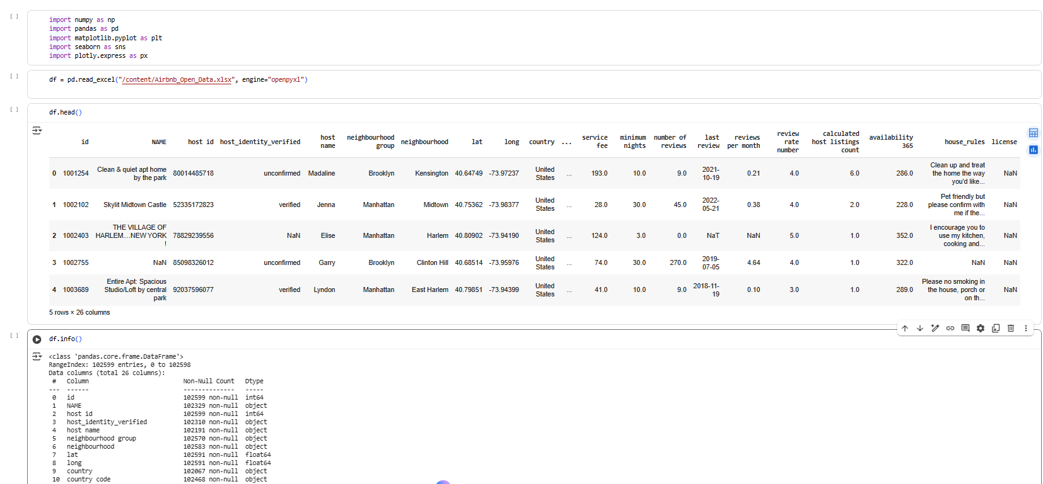
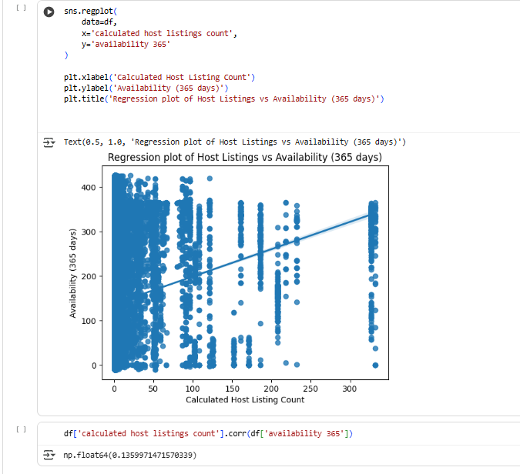
RESULTS 1

Slide 7
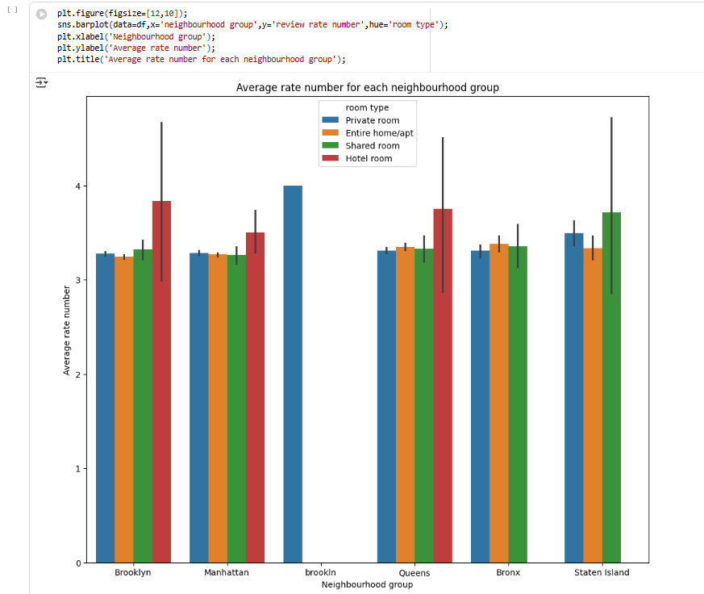
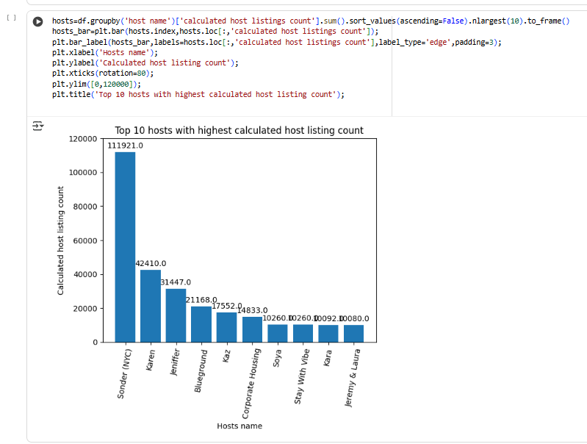
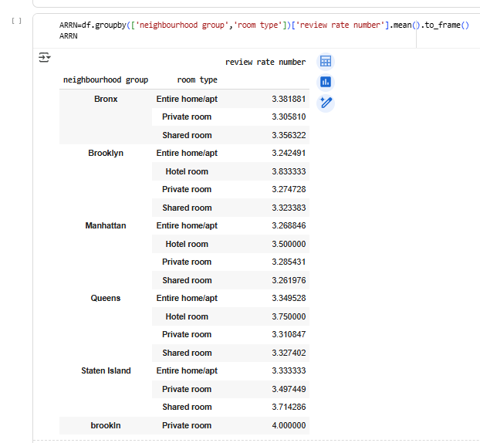

Slide 8
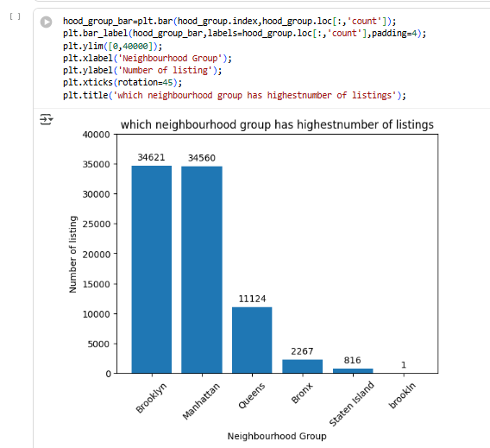
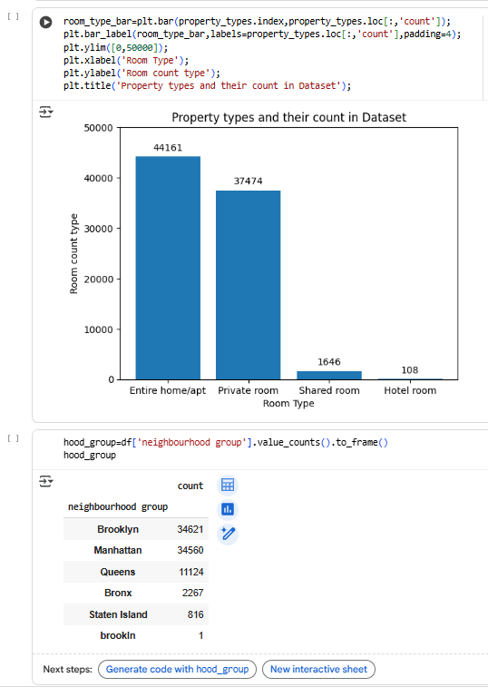
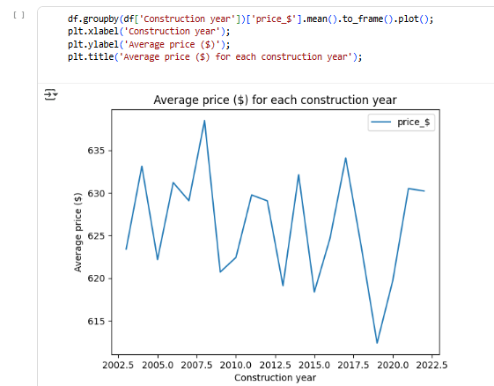
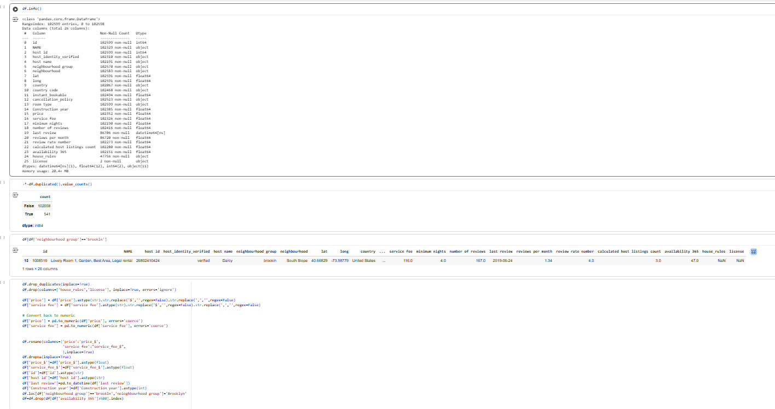

Slide 9
GIT Repository:
GIT Repository : https://github.com/Sudarshan-CSE/VOIS_AICTE_Oct2025_Sudarshan.git

Slide 10
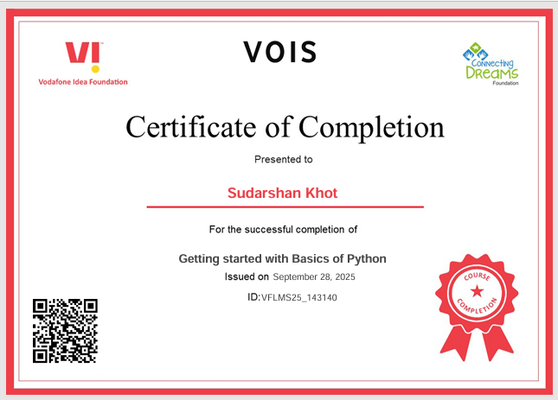
Getting started with Basics of Python Certificate

Slide 11
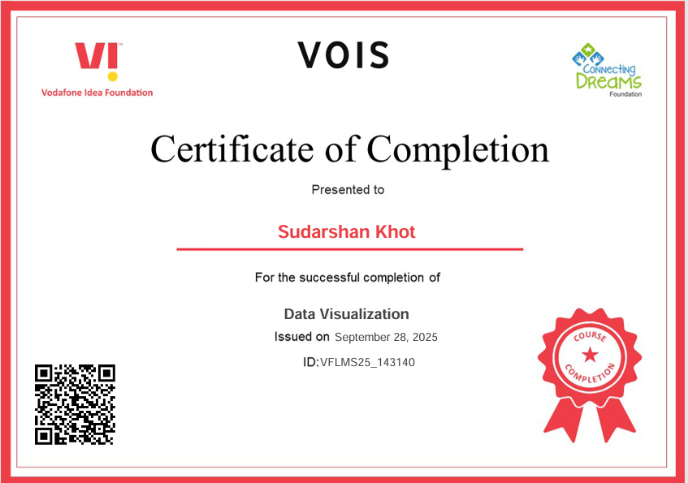
Data Visualization Certificates:

Slide 12
Thank you
.
.

